Slide 1
DESIGN AND IMPLEMENTATION OF AN E-VOTING SYSTEM (CASE STUDY NACOSS, FEDERAL POLYTECHNIC, MUBI ) BY SUNDAY PHILIP (ST/CS/HND/21/054) BEING A PROJECT PROPOSAL SUBMITTED TO THE DEPARTMENT OF COMPUTER SCIENCE, SCHOOL OF SCIENCE AND TECHNOLOGY, FEDERAL POLYTECHNIC, MUBI, ADAMAWA STATE. IN PARTIAL FULFILMENT OF THE REQUIREMENTS FOR THE AWARD OF HIGHER NATIONAL DIPLOMA (HND) IN COMPUTER SCIENCE. PROJECT SUPERVISOR: MR. YAYIRUS GARBA ULEA JULY, 2023

Slide 2
BACKGROUND TO THE STUDY
In the modern era, technology has permeated almost every aspect of human life, including governance and decision-making processes. Voting is a fundamental democratic process that allows citizens to participate in the selection of their representatives and the decision-making process. Traditionally, voting has been conducted using paper-based systems, which can be time-consuming, prone to errors, and vulnerable to manipulation.
E-voting systems leverage technology to facilitate the casting and counting of votes electronically, offering advantages such as increased efficiency, accuracy, and transparency. These systems can streamline the voting process by automating various tasks, including vote casting, counting, and result announcement.

Slide 3
PROBLEM STATEMENT
The existing paper-based voting system used by NACOSS at the Federal Polytechnic, Mubi, suffers from several limitations and challenges. These include:
Error-prone: Manual data entry and vote counting processes are susceptible to human errors, which can compromise the accuracy and reliability of the election results.
Verification challenges: With a paper-based system, it can be challenging to verify the authenticity and integrity of votes, leading to doubts and disputes regarding the election outcomes.
Potential for fraud: Paper-based systems are vulnerable to various fraudulent activities, such as ballot stuffing or tampering with ballot boxes, which can undermine the credibility and fairness of the elections.
One person can vote more than one time.

Slide 4
AIM AND OBJECTIVES
The aim of this project is to design and implementation of an e-voting system for NACOSS, Federal Polytechnic, Mubi. The specific objectives of this study are as follows:
To design an e-voting system tailored to the specific requirements of NACOSS, Federal Polytechnic, Mubi.
To implement the e-voting system and ensure its usability, reliability, and security.
To evaluate the effectiveness of the e-voting system in terms of efficiency, accuracy, and transparency.
To control over voting.

Slide 5
DISADVANTAGES OF EXISTING SYSTEM
Voters need to physically travel to the polling stations, wait in queues, and manually mark their ballots. This process can result in long waiting times and delays in vote counting. Manual voting is susceptible to human errors. Both voters and electoral staff may make mistakes while marking the ballots or recording the votes. These errors can lead to inaccurate vote counts and potentially impact the election results. The existing system of voting poses challenges for individuals with disabilities or those who are unable to travel to the polling stations. Manual voting systems are vulnerable to security risks such as ballot tampering, fraudulent activities, or misplacement of ballots. Without robust security measures, it becomes difficult to ensure the integrity and confidentiality of the voting process. Manual voting processes may lack transparency, making it challenging for stakeholders to verify the fairness and accuracy of the election results. Without a clear audit trail, it becomes challenging to track and resolve any discrepancies or disputes that may arise.

Slide 6
ADVANTAGES OF PROPOSED SYSTEM
The proposed E-Voting system for NACOSS at Federal Polytechnic, Mubi offers several advantages over the existing manual voting system. Some of the key advantages of the proposed system are:
Increased Efficiency
Enhanced Accuracy
Improved Accessibility
Enhanced Security
Improved Transparency
Cost-effective
Efficient Data Management

Slide 7
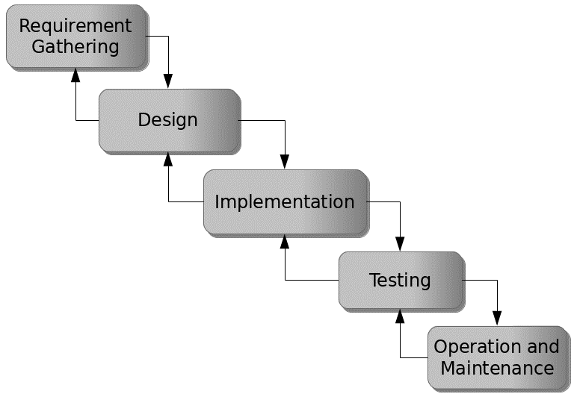
PROPOSED METHOD
The waterfall model is a traditional sequential approach to software development that consists of distinct phases that follow a linear sequence. Figure 3.1 below is a simplified version of the waterfall model for the development of an E-Voting system for NACOSS at Federal Polytechnic, Mubi:
Figure 3.1: Waterfall model

Slide 8
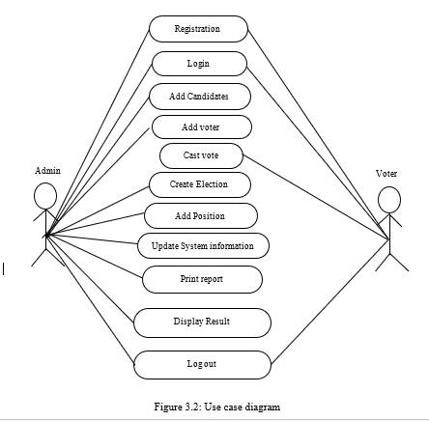
UML ALGORITHM
Use case diagram

Slide 9
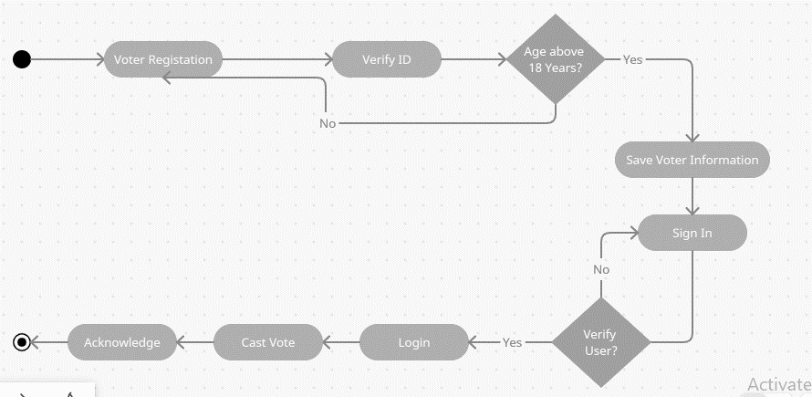
Activity diagram

Slide 10
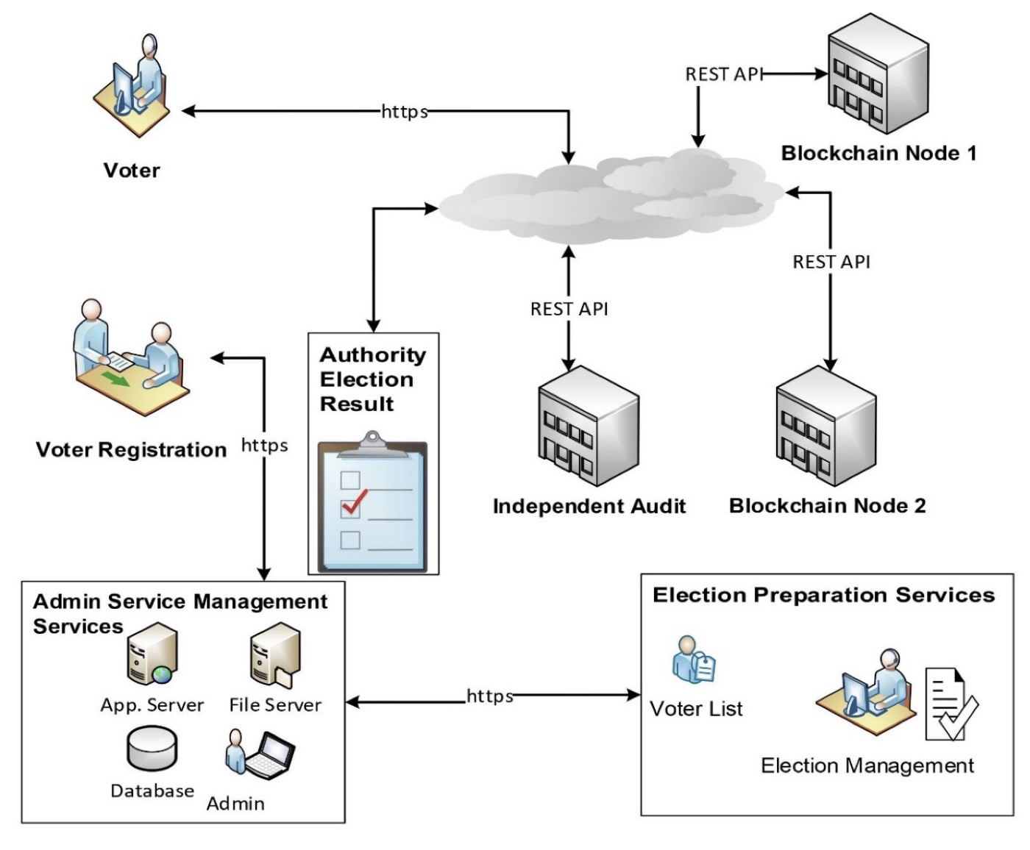
SYSTEM ARCHITECTURE

Slide 11
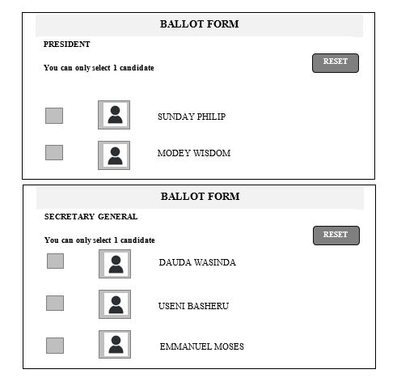
EXPECTED OUTCOME

Slide 12
REFERENCES
Kreischer, C., & Krimmer, R. (2021). Electronic Voting in Europe: Innovations and Challenges. In Proceedings of the 12th International Conference on Electronic Voting (EVOTE 2021), 53-61.
Magkos, E., & Mentzas, G. (2021). Blockchain for Secure and Transparent E-Voting: A Systematic Literature Review. International Journal of Electronic Government Research, 17(1), 1-23.
Osório, A., Santos, J., & Morais, M. (2020). E-Voting System with Blockchain and Blind Signature. In Proceedings of the 15th Iberian Conference on Information Systems and Technologies (CISTI), 1-6.
Schürmann, C., & Krimmer, R. (2021). Improving Usability in E-Voting Systems: A Systematic Review of International Research. Government Information Quarterly, 38(1), 101513.
Trabelsi, S., Abid, M., & Mrabet, H. (2020). Towards a Secure E-Voting System Based on the Internet of Things and Blockchain. In 2020 International Conference on Wireless Networks and Mobile Communications (WINCOM), 1-6.

Slide 13
THANKS FOR LISTENING

